Slide 1
WordPress
Workshop
Lou Judice
TCF 2019
March 23, 2019

Slide 2
Objective
How to get started in WordPress
Blog
Photoblog
Business or Organization site
Tips & Tricks
Examples

Slide 3
About Me
30+ years RCA, GE, DEC, HP - engineering, marketing, consulting, etc.
Founder of RMG: Consulting, Design, Hosting
Developed 100’s of WordPress sites
40+ sites under management: Corporate, Government, Small / Medium Business
TCF Board Member

Slide 4
WordPress is the worst system in the world for building a website.
Except for ALL
of the others.

Slide 5
What Is WordPress?
WordPress is a Content Management System
A content management system (CMS) is a computer application that supports the creation and modification of digital content. It typically supports multiple users in a collaborative environment. Examples: WordPress, Joomla, Drupal, SiteCore
WordPress is Freely Distributed, Open Source
WordPress is based on PHP and MySQL
Search Engine Friendly

Slide 6
WordPress
Most popular web publishing platform
Over 60 million sites
Over 30% of the top 10 million sites
Getting a site up and running (and maintaining it) is relatively easy.
Editing content is very easy
Mobile friendly (using responsive themes)
Advanced features require extensive expertise

Slide 7
Downsides
Lot of overhead for simple sites
Annoying editor
So popular, its a hacker magnet
Brute Force attacks
But with care (which we will cover) it is very secure
If you don’t plan to maintain your site and keep it up to date, get someone to do it for you.

Slide 8
How I Got Started With WordPress

Slide 9
Alternatives
Joomla/Drupal: feature rich, complicated, good for big teams
Sitecore: steep learning curve, expensive
Wix: very limited, proprietary system
Facebook: at their mercy
Google+ (see Facebook)

Slide 10
How to Get Started
You’ll need a domain name from a registrar and a host…
Lots out there but for getting started, I recommend wordpress.com which offers low cost paid plans.
Any LAMP (Linux Apache MySQL PHP) host will do
Many hosts offer WordPress packages.
Self hosting on your own server.
Hire an agency or individual

Slide 11
Basics
Dashboard
Pages
Posts
Media Library
Plugins
Themes

Slide 12
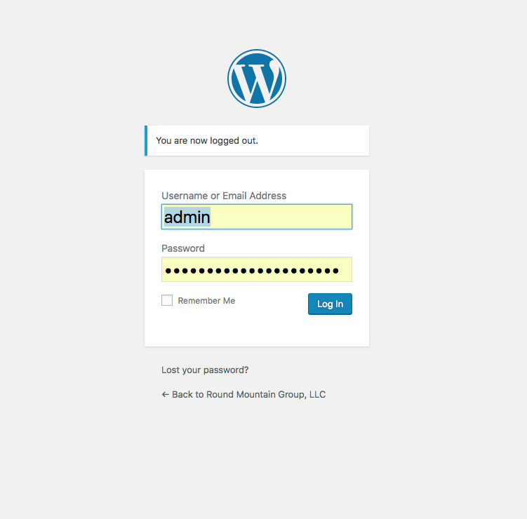

Slide 13
Dashboard
Control Center of WordPress
Install and Remove Components
Create content
Upload things

Slide 14
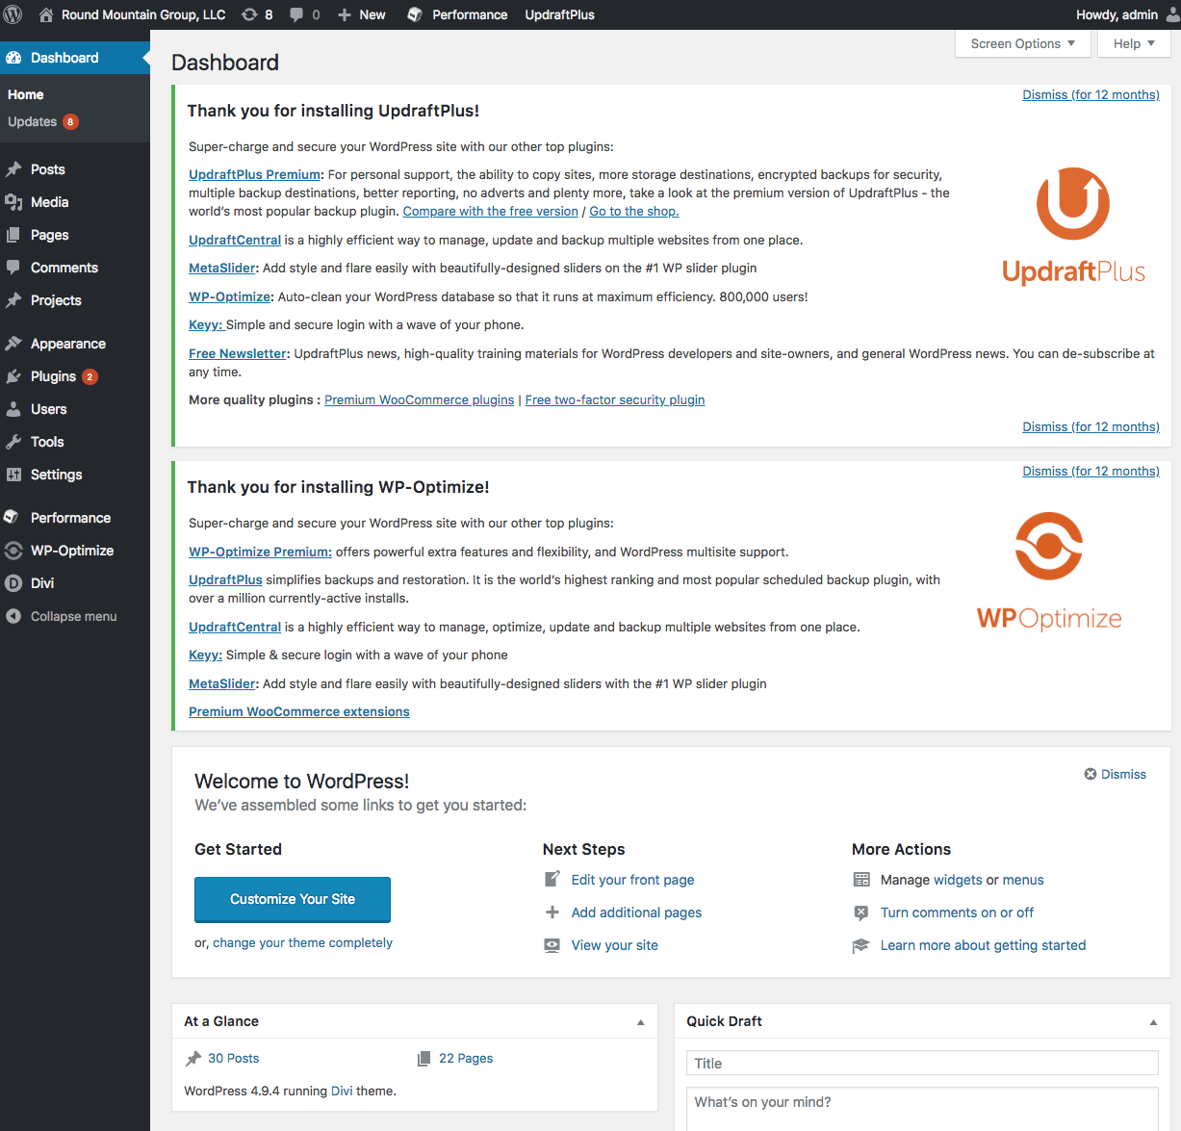

Slide 15
Posts and Pages
The two most common forms of content are:
Pages - the individual, permanent parts of a website hierarchically organized by menus
Posts - usually chronologically ordered content of text and/or images organized by category
Some sites are all pages. Some all posts. Or a mixture.
Posts can be used in clever ways in non-blog sites.

Slide 16
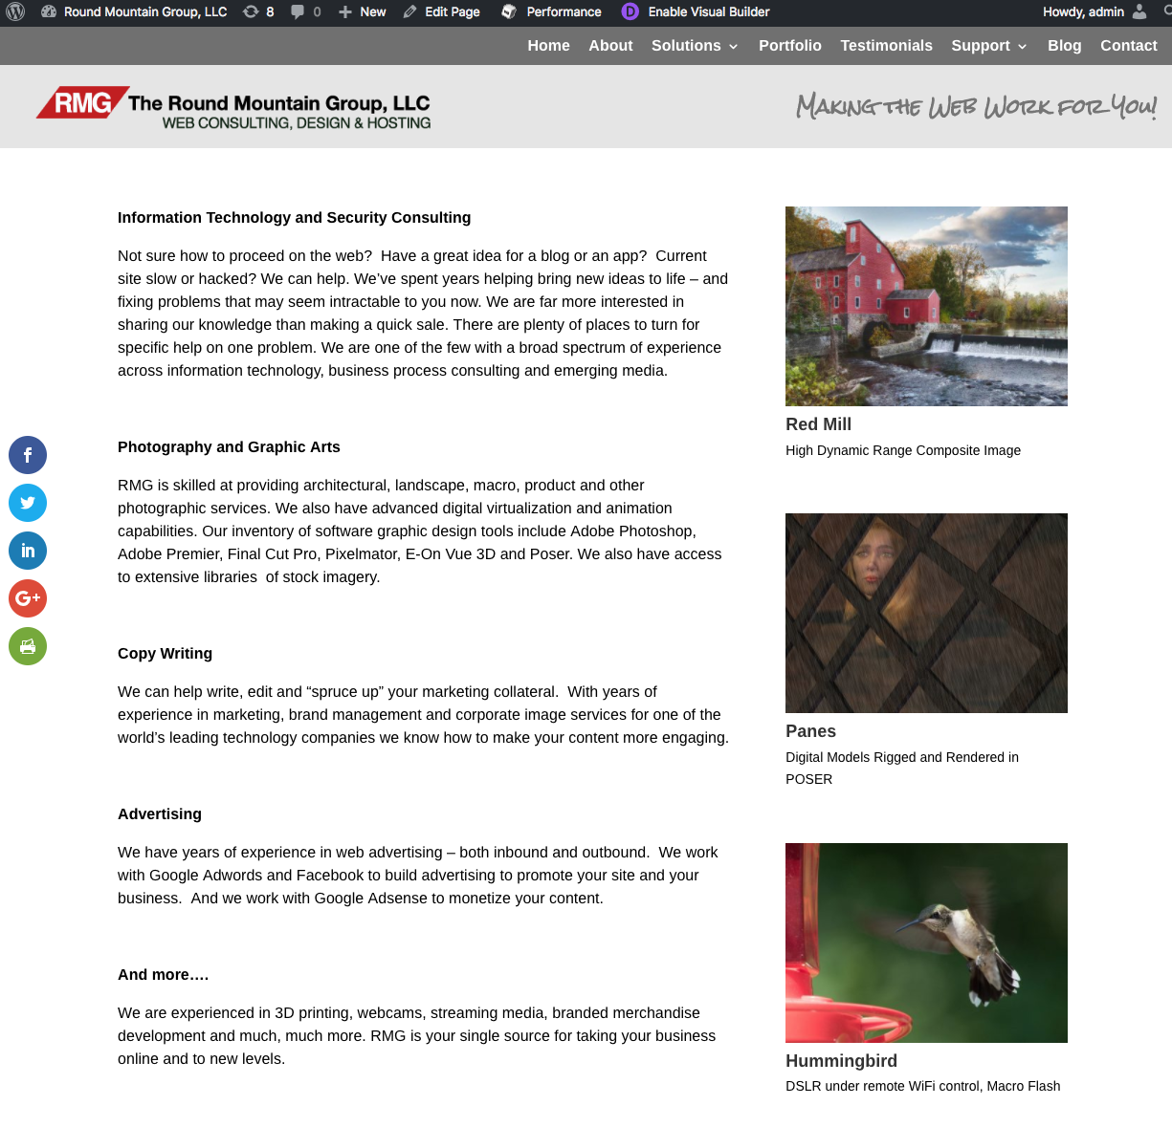
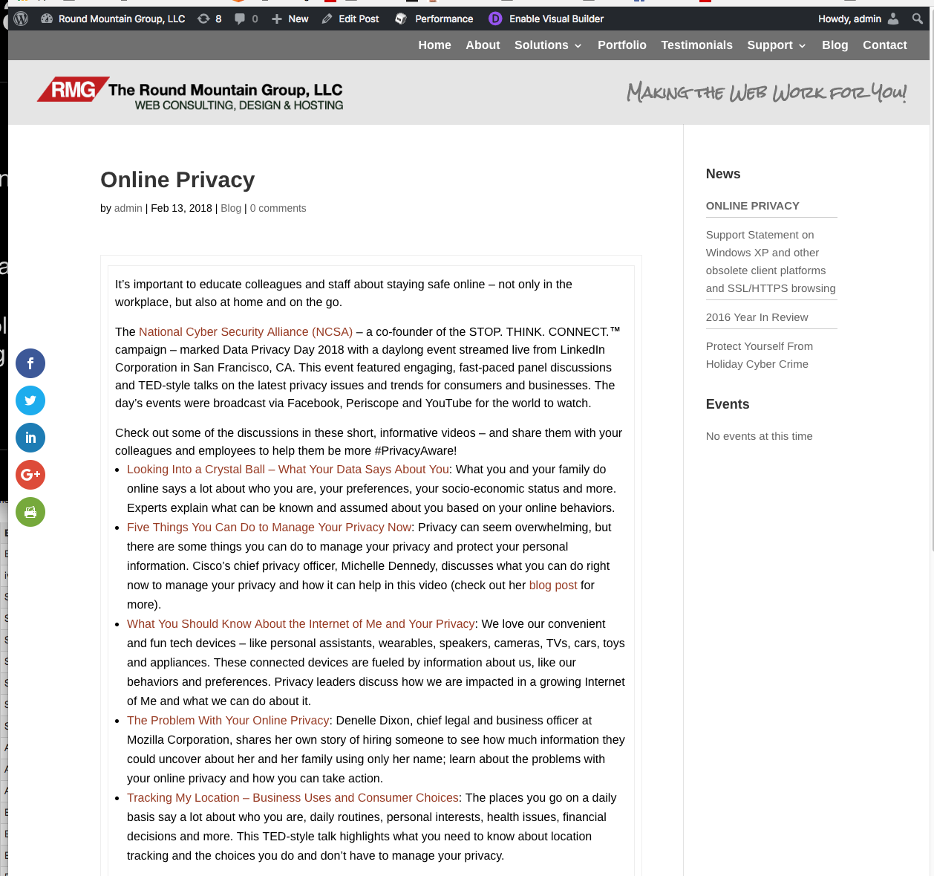
Page
Post

Slide 17
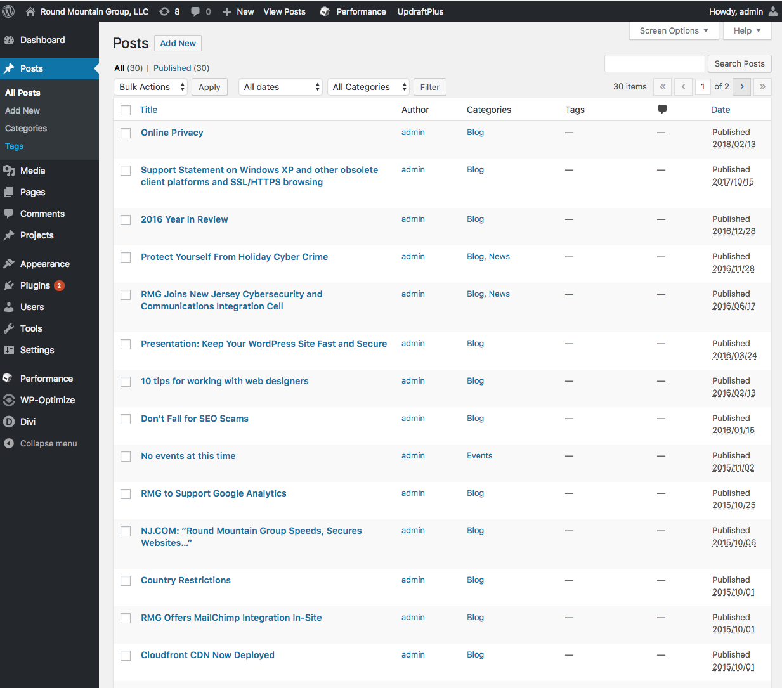

Slide 18
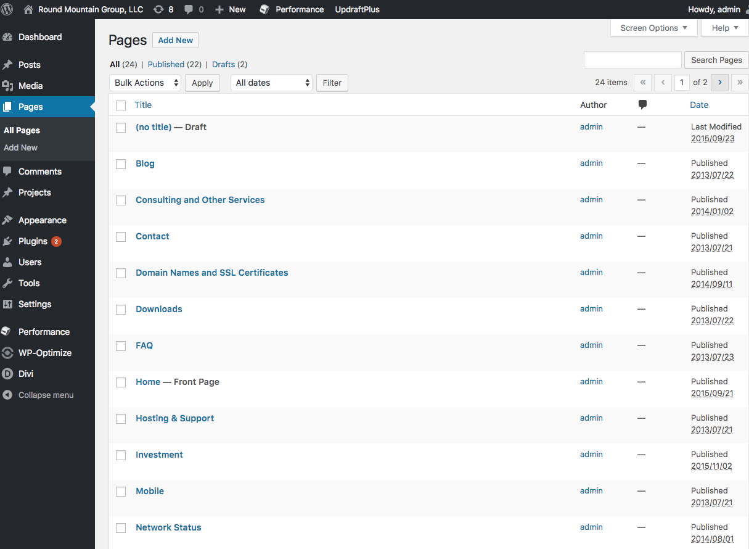

Slide 19
Themes
Themes provide the look and feel of your site
Determine mobile readiness
Some provide advanced capabilities
Meta themes, builder themes, etc.
Many are free or a nominal cost
Pick responsive (mobile ready) themes which have a support history (ie. not ones last updated 5 years ago)

Slide 20
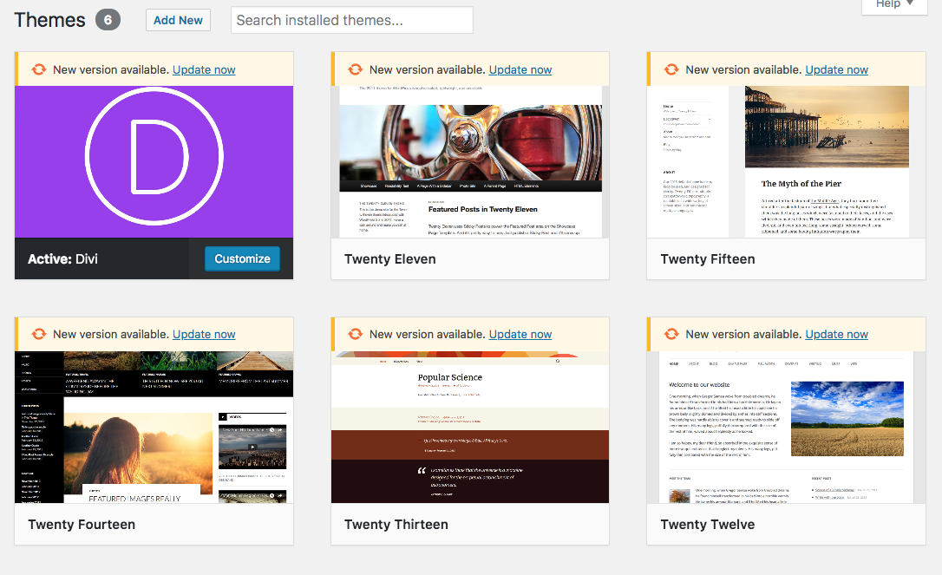

Slide 21
Plugins
Plugins add capabilities
50,000+ available
Be wary of support level, usage, version compatibility
Plugins are a common attack vector
Security, e-commerce, font extensions, slideshows, banners, email functions, performance etc.

Slide 22
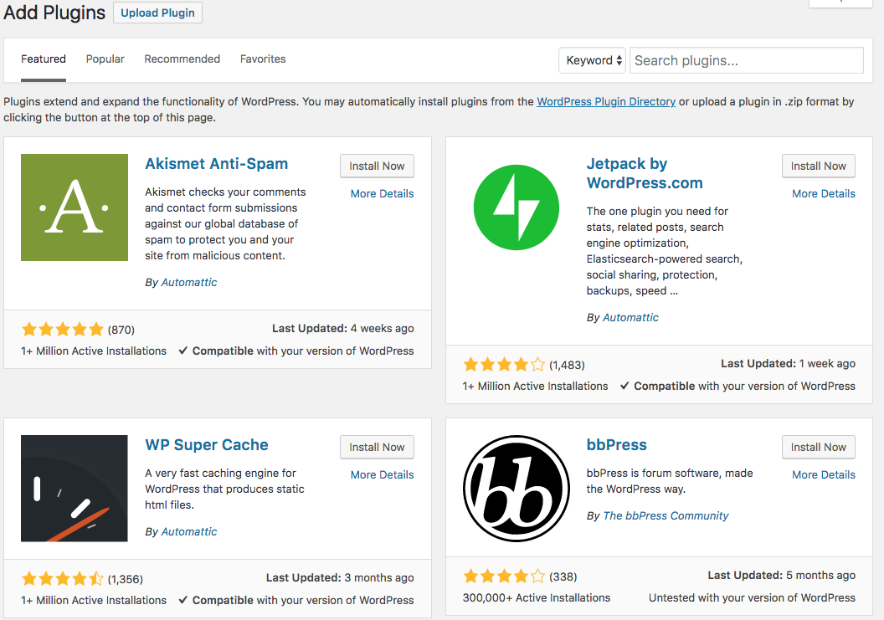

Slide 23
Media
Images
PDF’s
DOC, PPT but beware of client compatibility
Videos (not recommended, use YouTube or Vimeo)

Slide 24
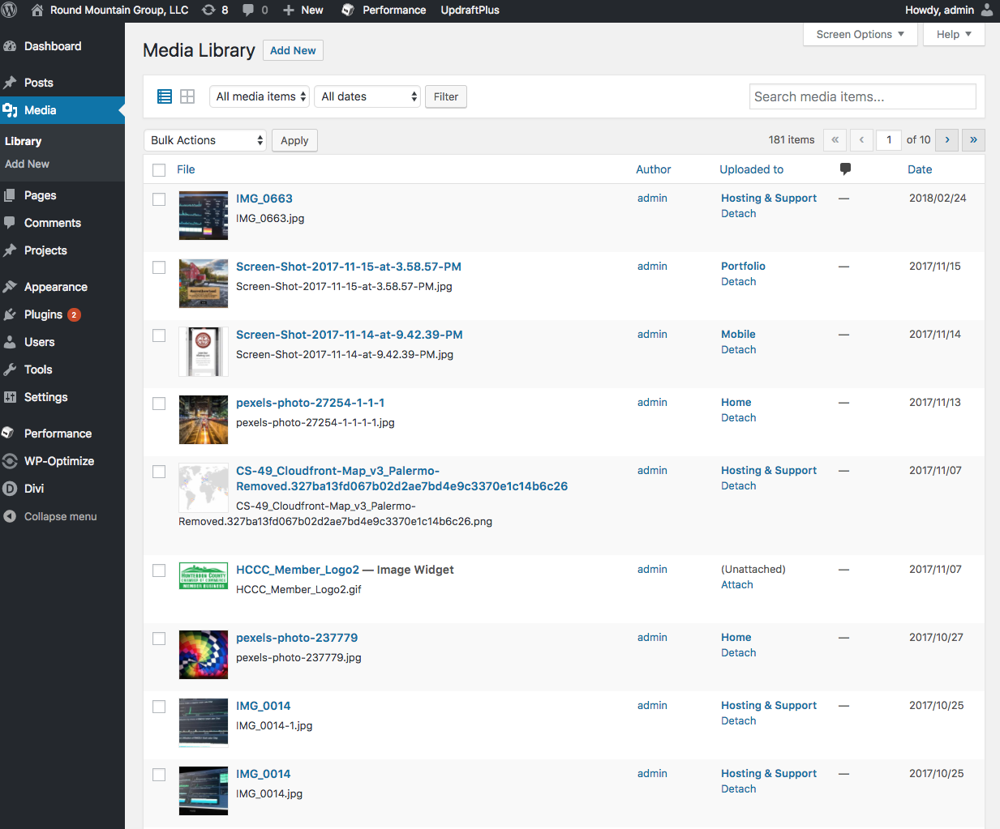

Slide 25
Comments
If not needed - turn off
If needed set to require approval or enable logins
You will be spammed - unforeseen consequences

Slide 26
Divi
Divi is a framework “theme” from ElegantThemes.com
300,000 users (many agencies)
block oriented design
Many functional modules
Very highly recommended
Need to install “Classic Editor” plug-in to disable V5.x block editor

Slide 27
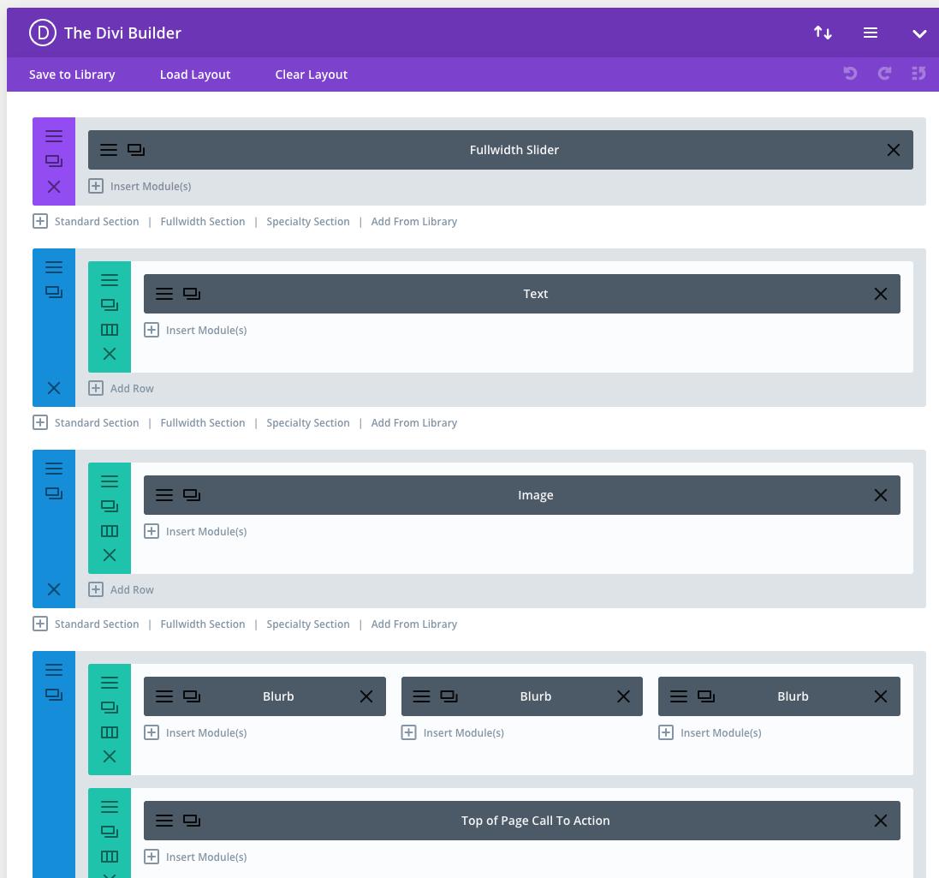

Slide 28
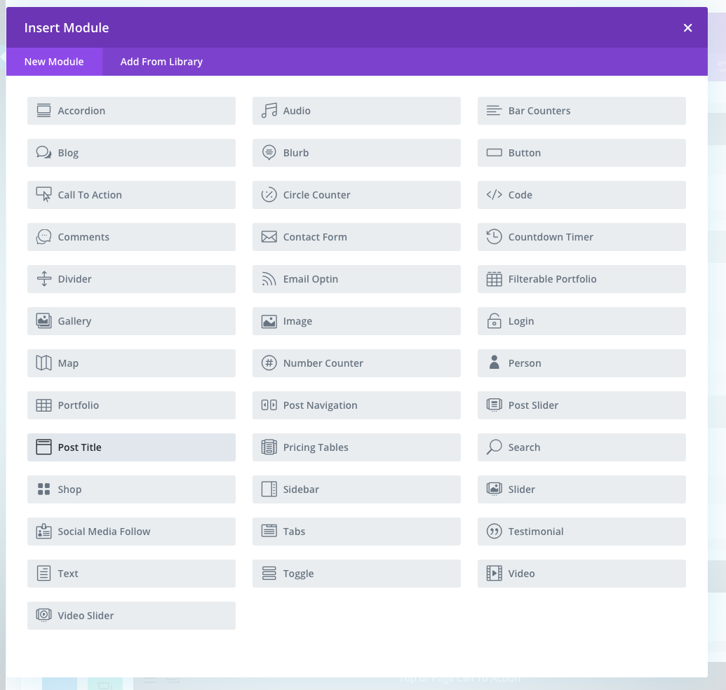

Slide 29
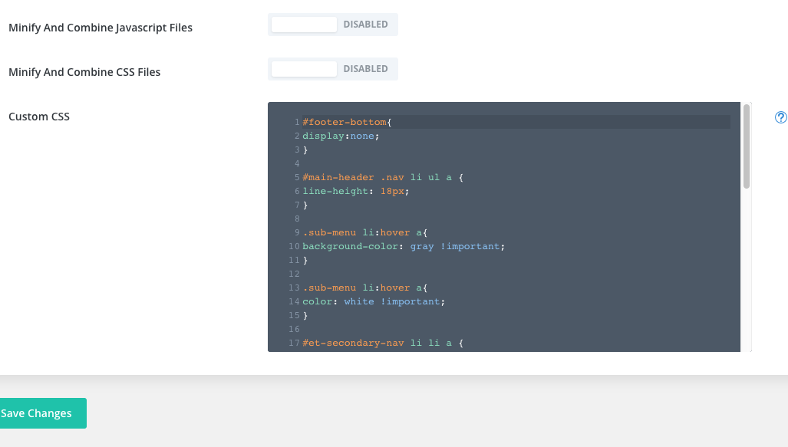

Slide 30
WooCommerce
Comprehensive e-commerce solution
Very widely used
Free…. well not really!
Extensive eco-system of add-ons and add-add-ons
Subscriptions, ticketing, membership, payment gateways, etc.
Challenging to fit complex real world business models
Customization demands real expertise
Never edit functions.php from dashboard

Slide 31
Mail
Mail is frequently part of a solution
Contact forms, transactional mail, etc.
Mail from programs is often detected as spam
Test, test, test
Easy WP Mail plugin to shift to SMTP
SMTP2GO, AWS SES for business grade solutions

Slide 32
SEO
Success on the web is about balance: content, user friendliness, backlinks, mobile, social media strategy.
There is no magic “SEO” trick to draw visitors or boost rankings.
Old ideas like keyword stuffing and hidden text will get you in trouble.
Plug-ins that maintain your XML Sitemap are useful

Slide 33
Support Resources
WordPress.org
Many WordPress focused blogs
Google any issue, you should find an answer
rmg.llc/downloads
This presentation + security primer

Slide 34
Examples

Slide 35
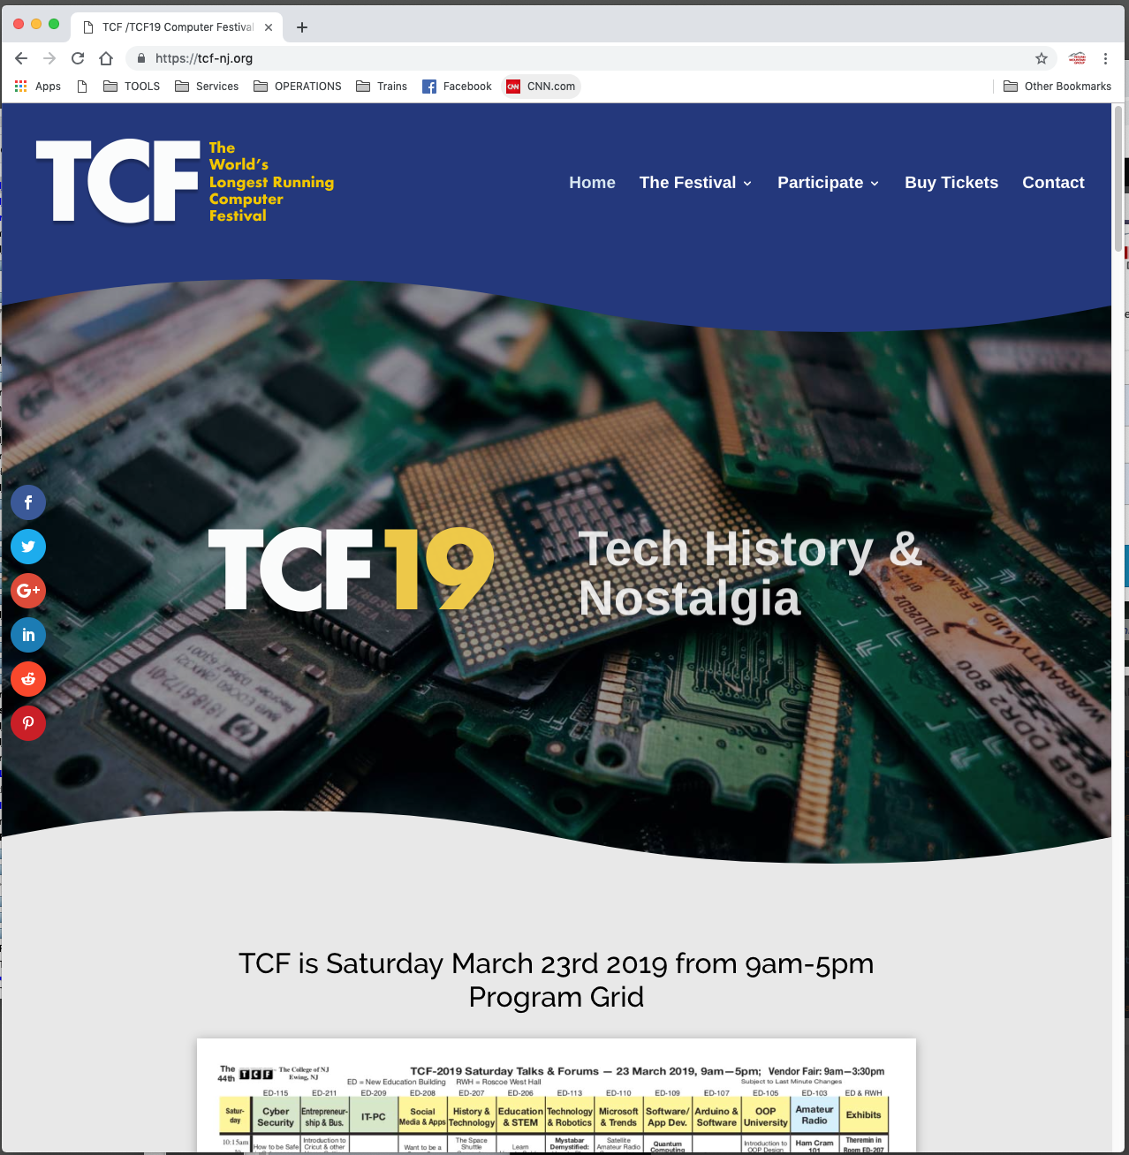

Slide 36
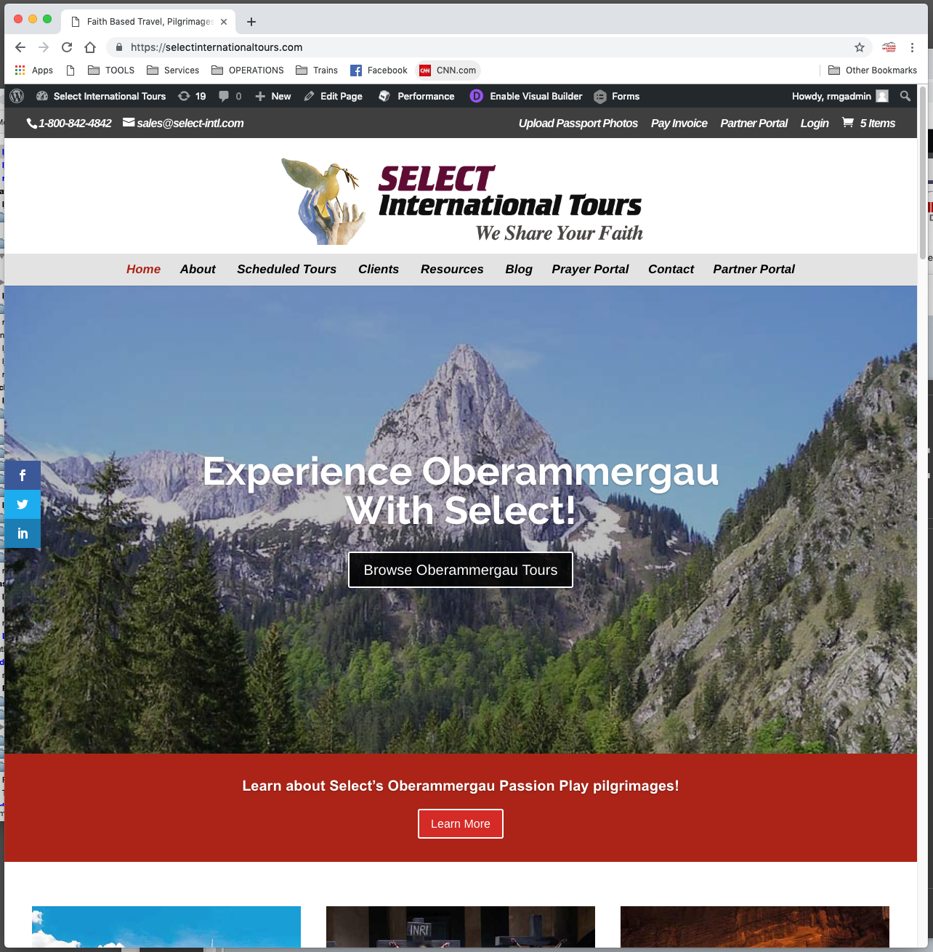

Slide 37
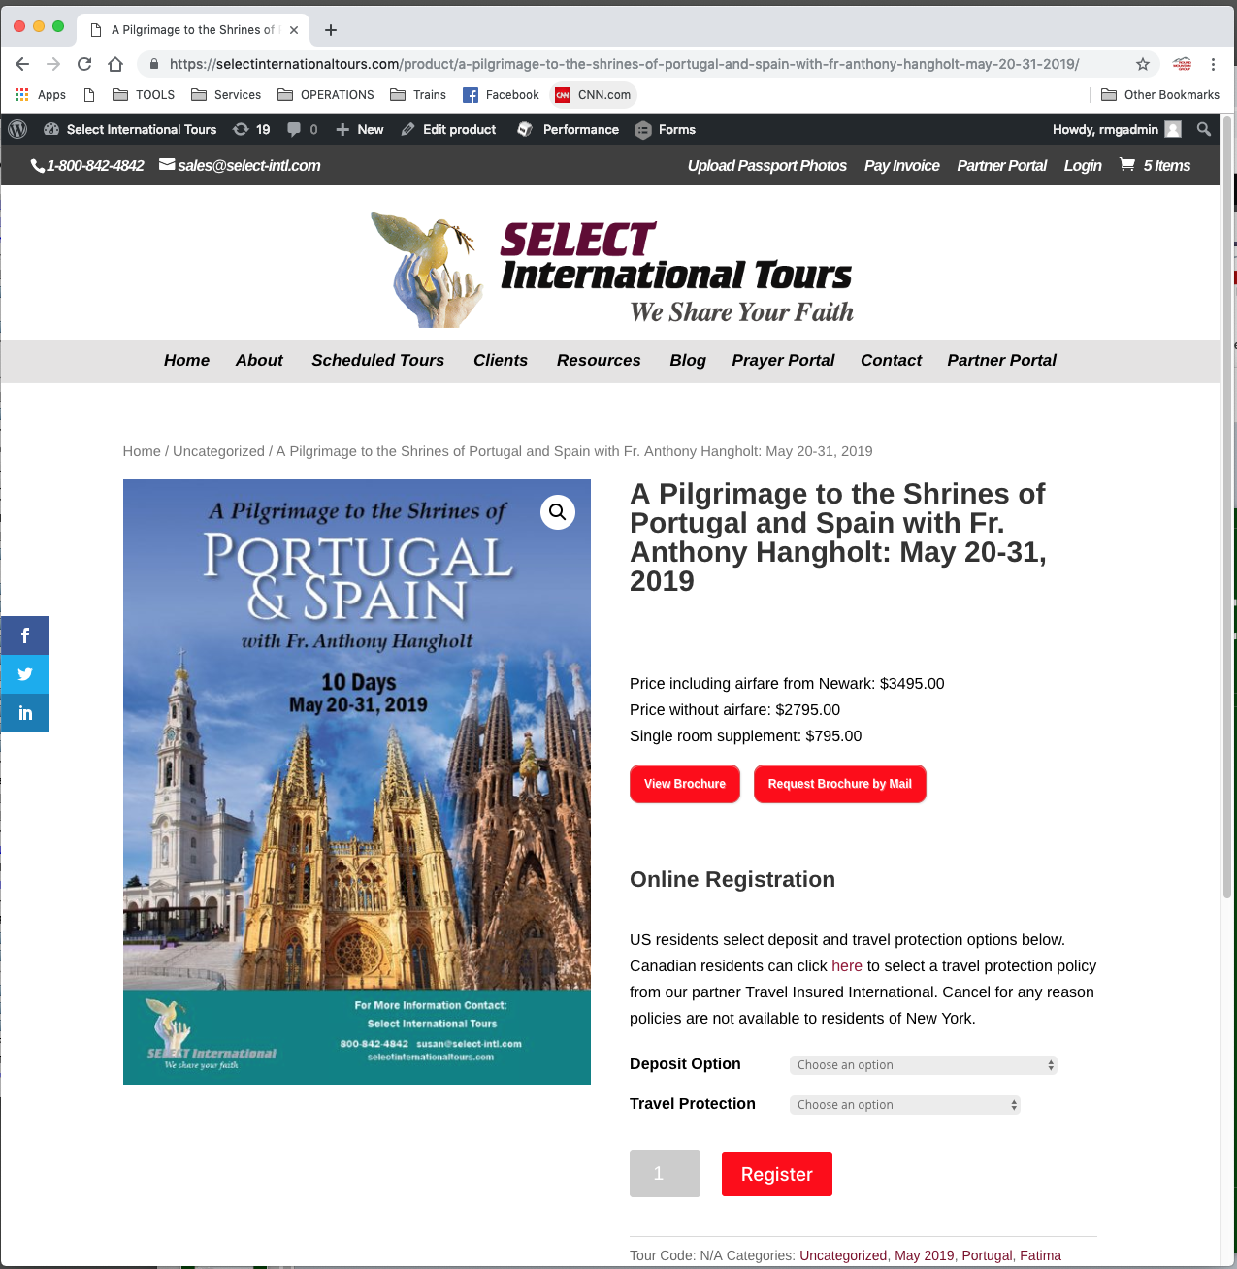

Slide 38
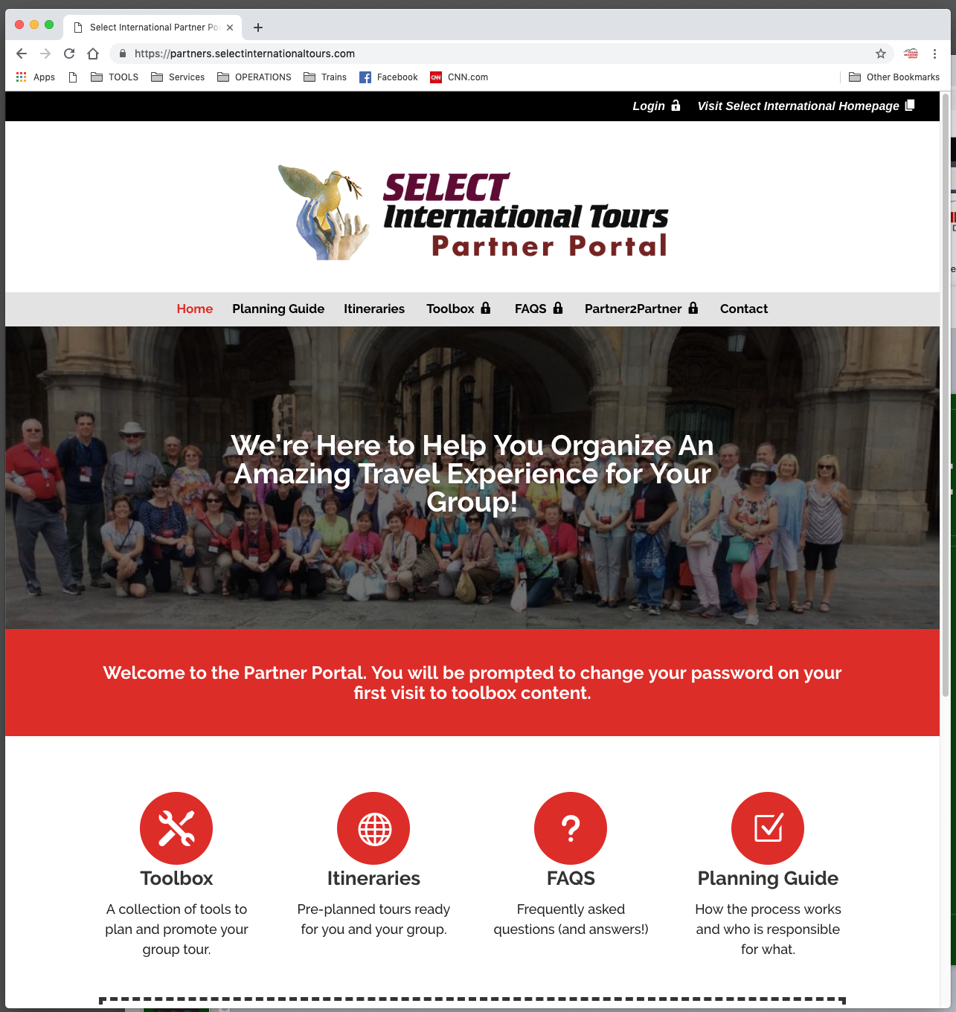

Slide 39
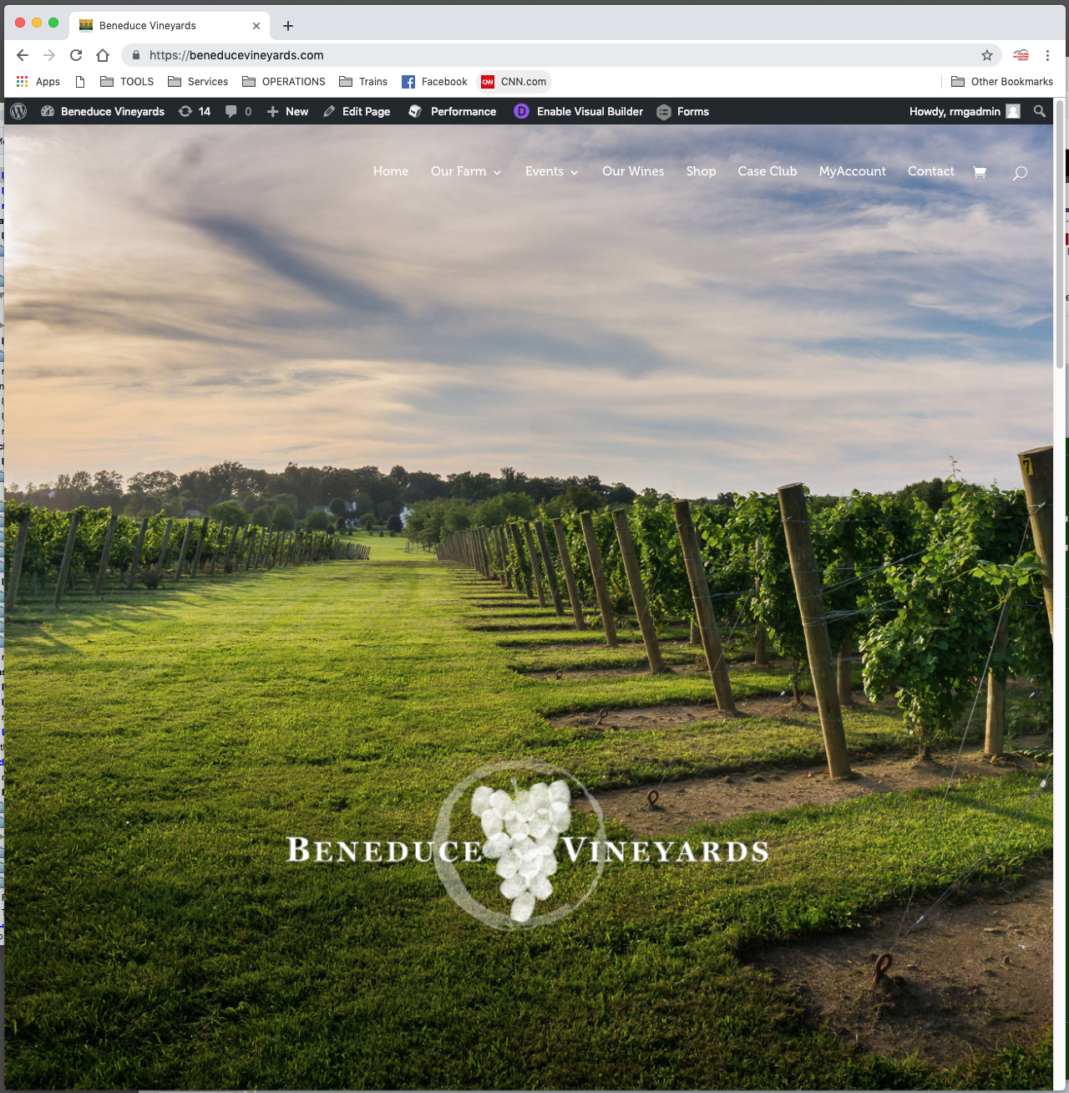

Slide 40
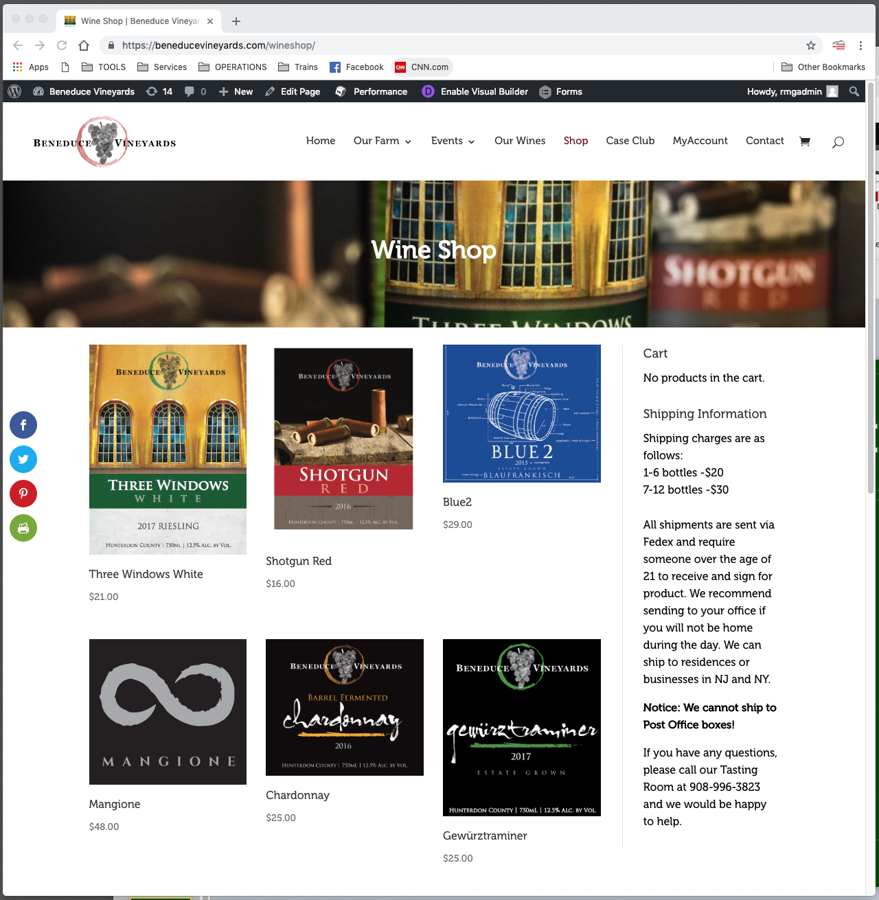

Slide 41
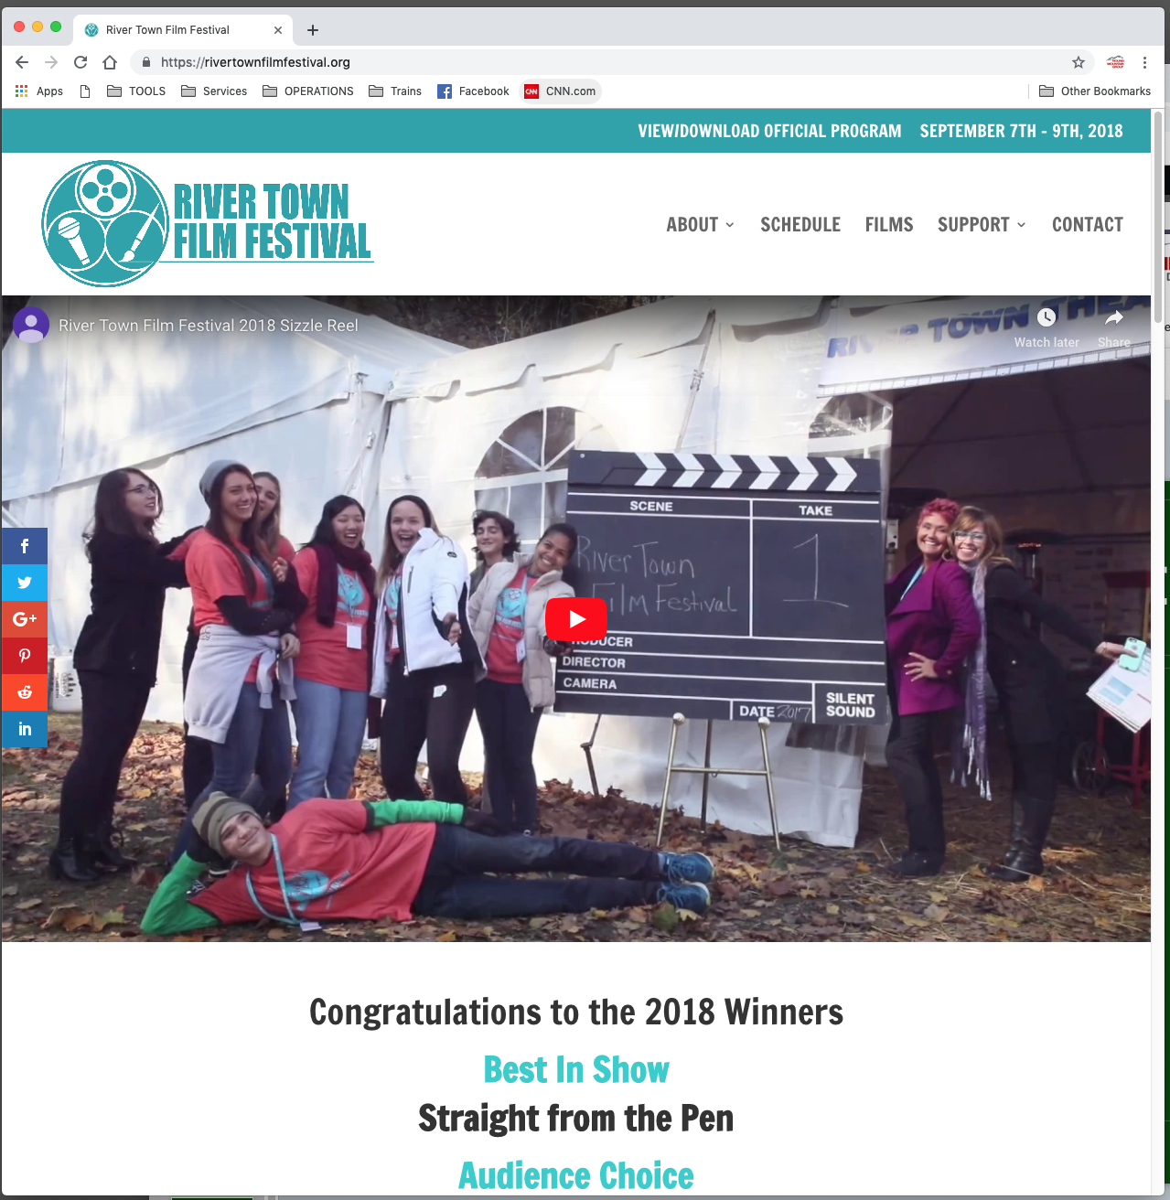

Slide 42
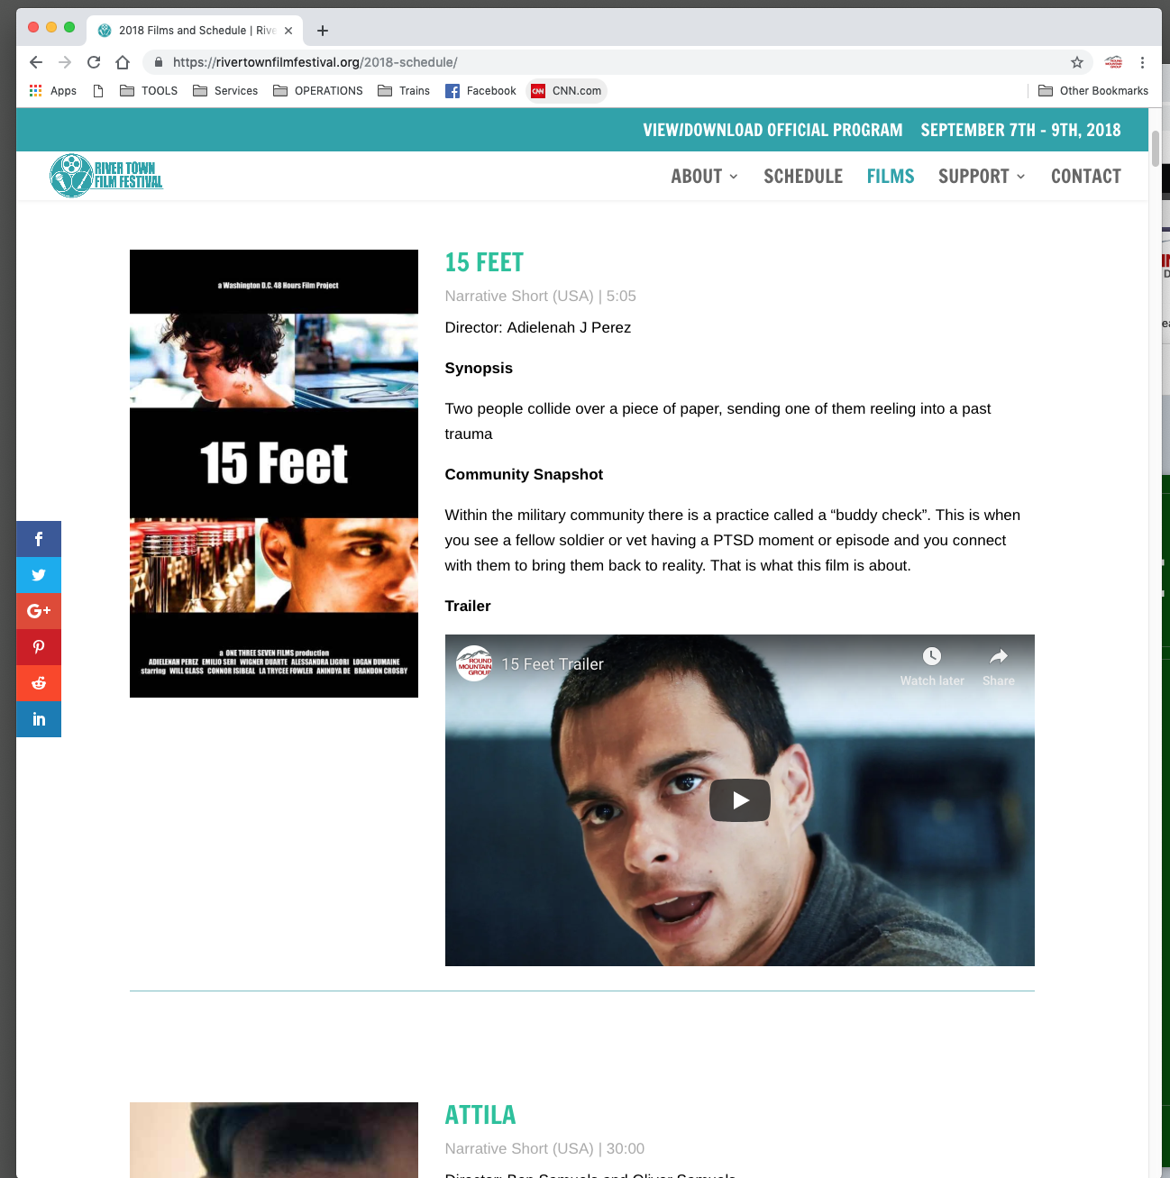

Slide 43
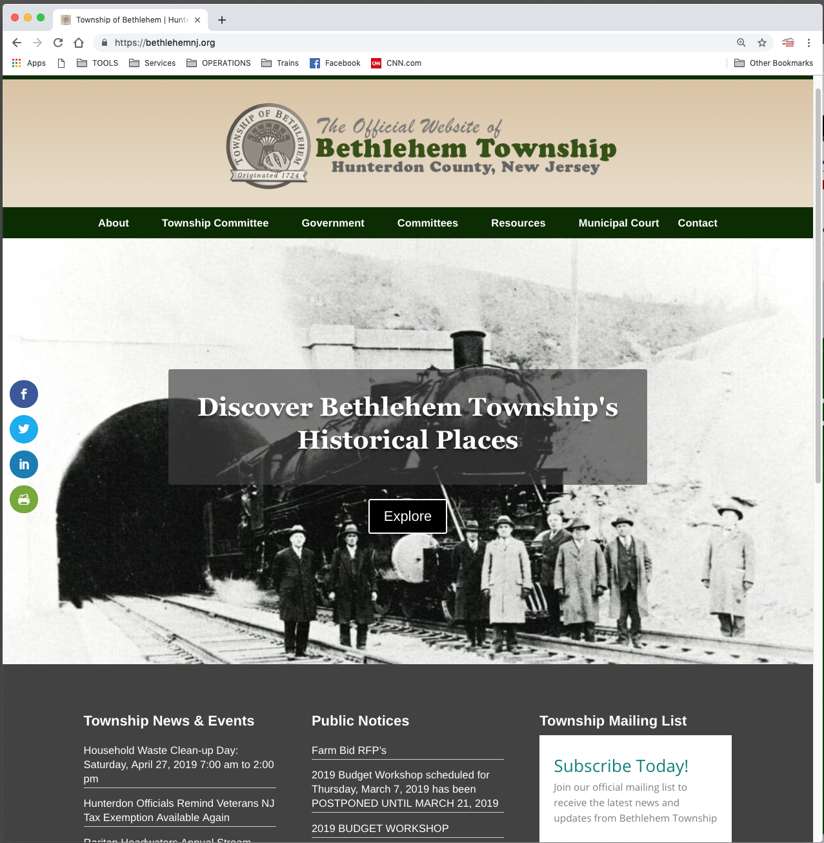

Slide 44
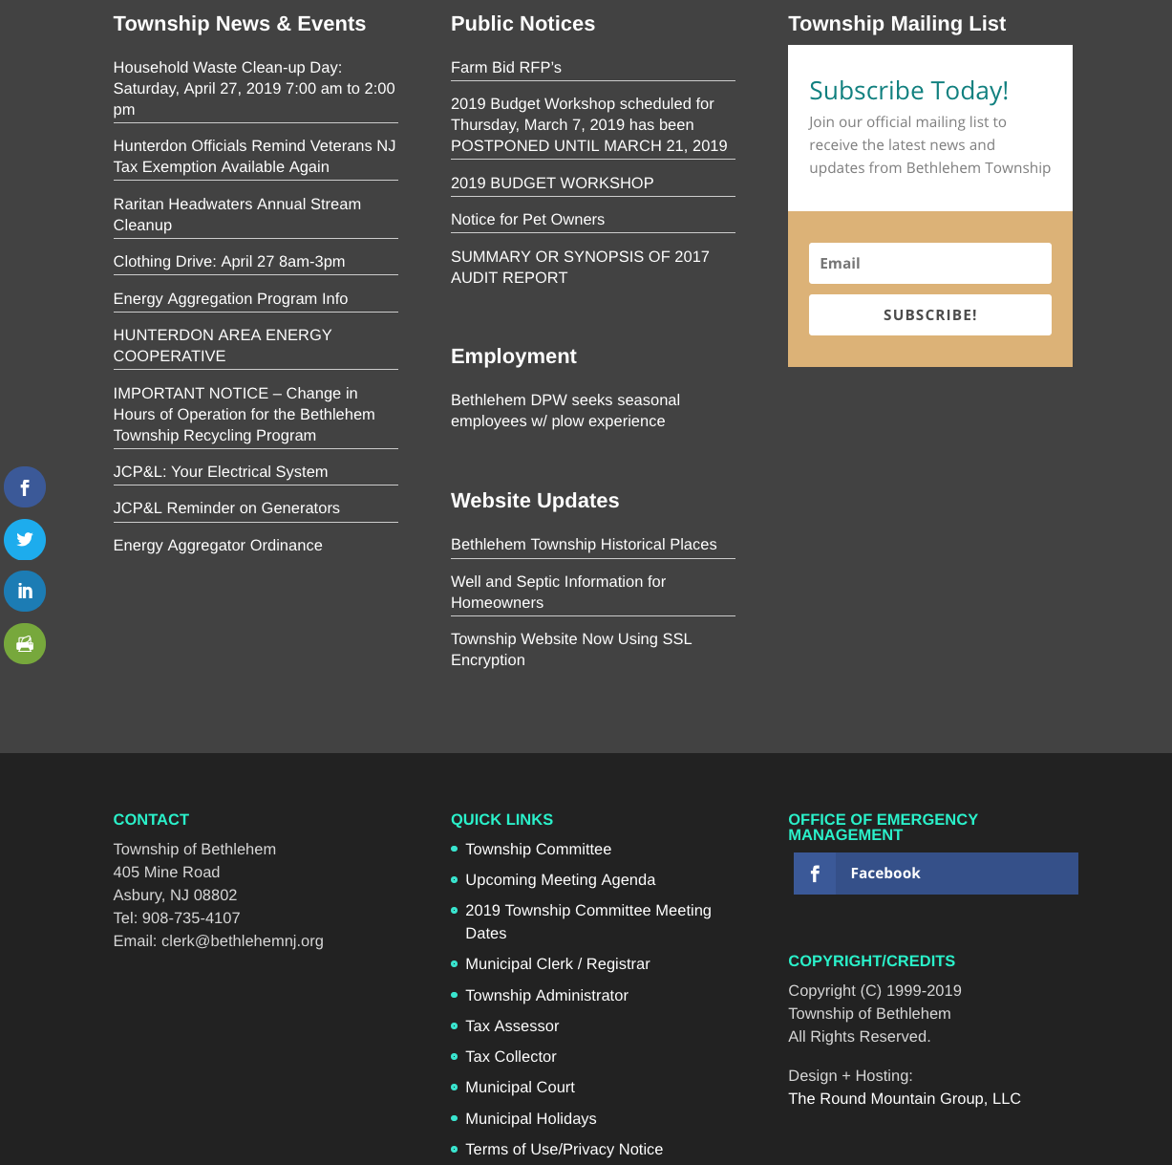

Slide 46
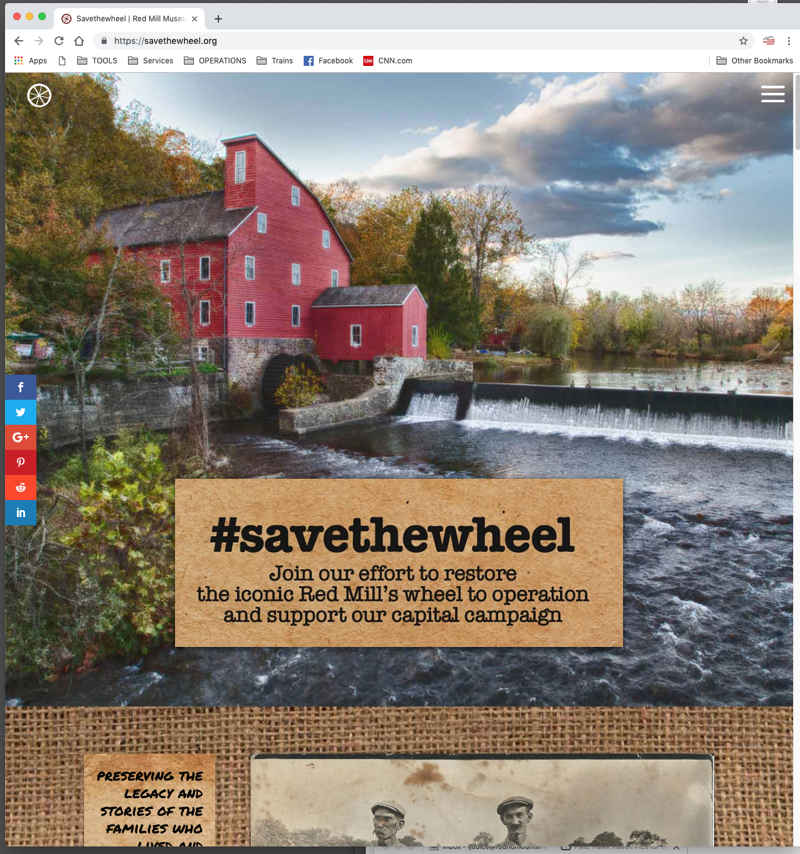

Slide 47
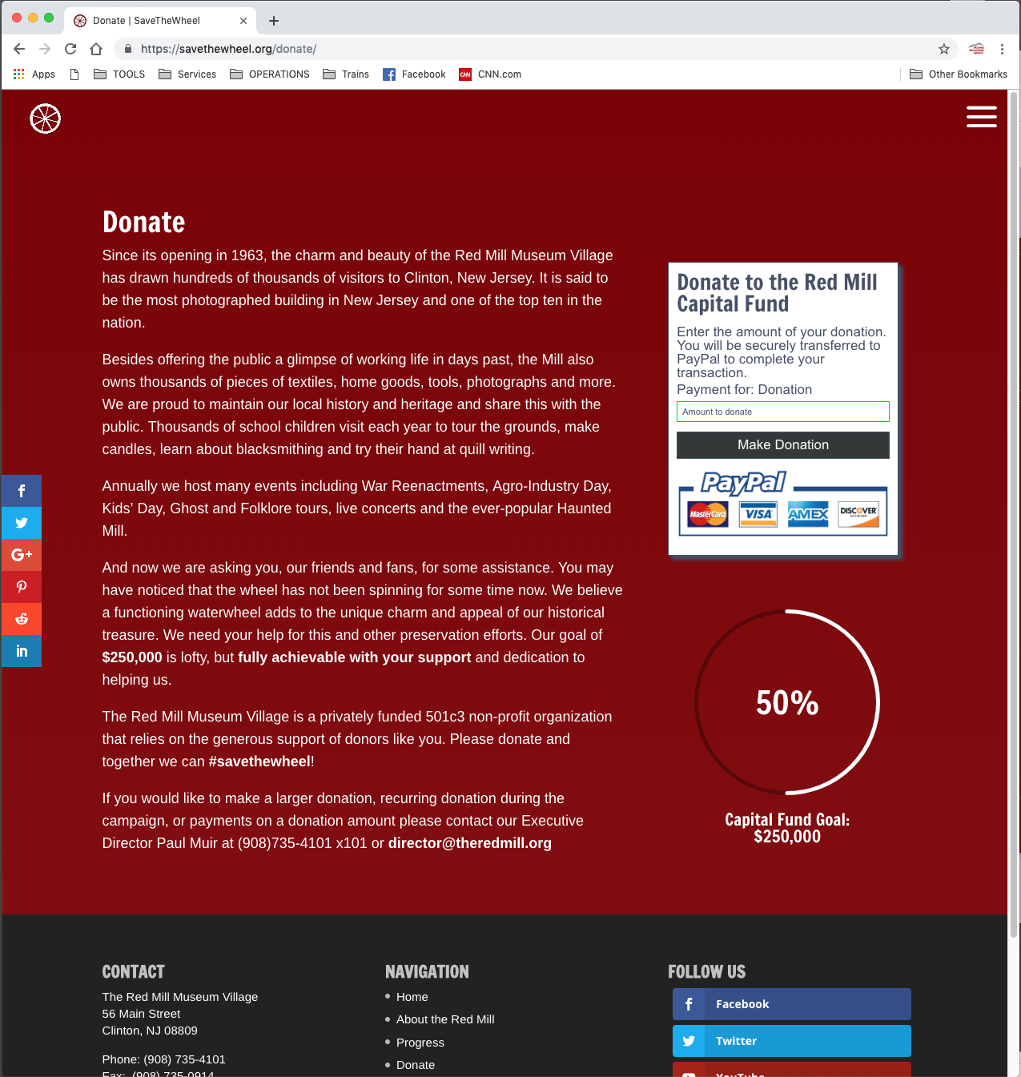

Slide 48
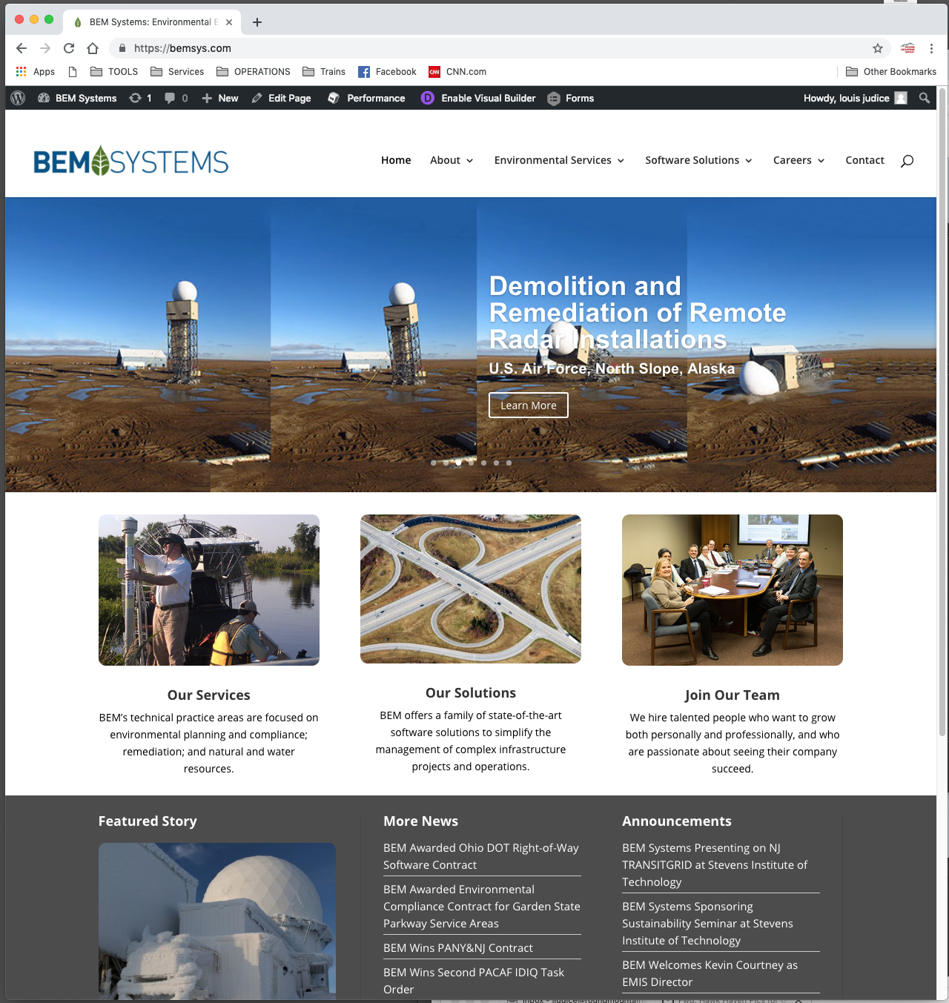

Slide 50
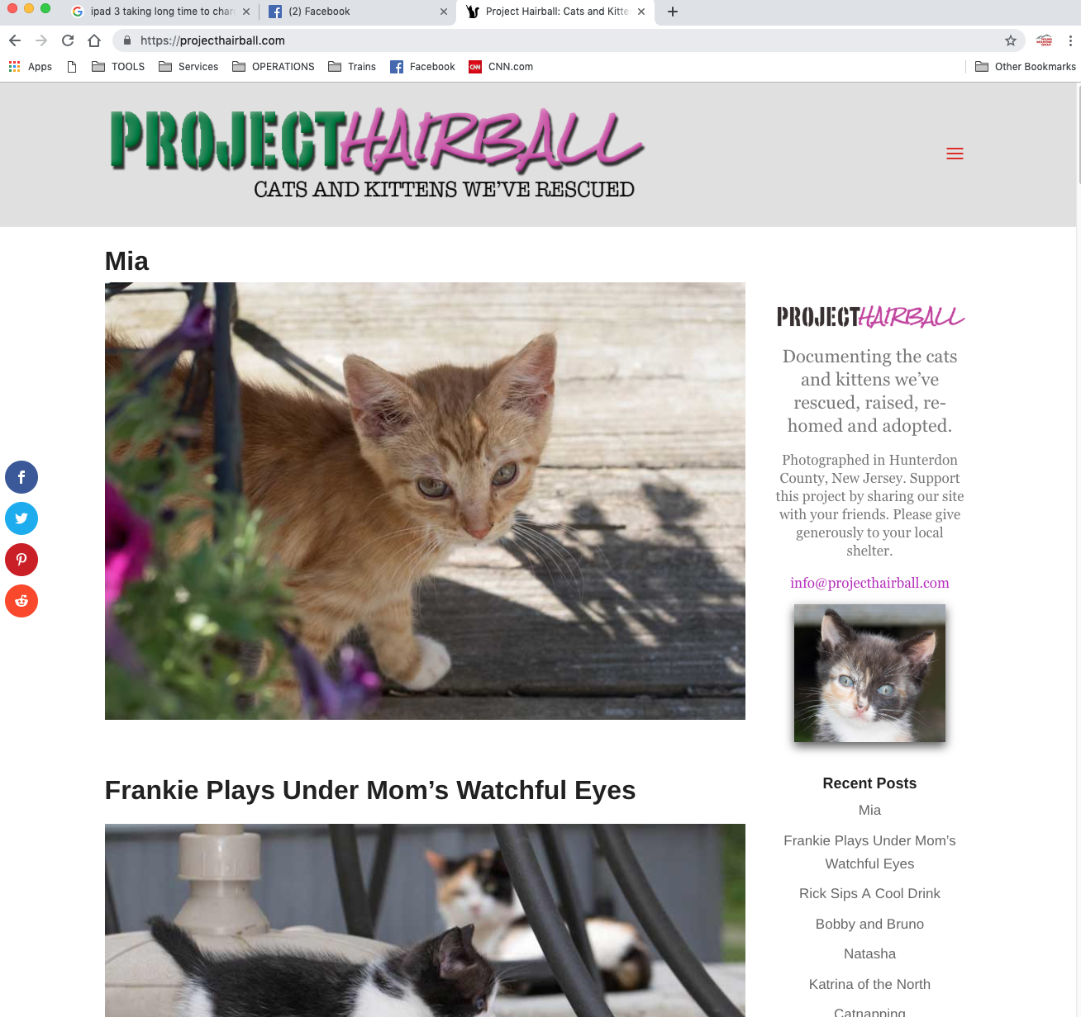

Slide 52
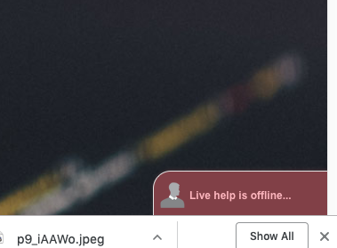

Slide 53
rmg.llc/downloads

